Slide 1
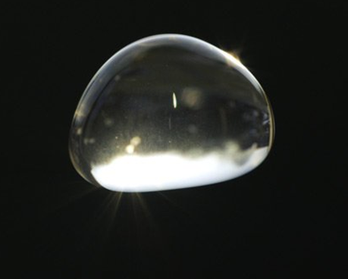
An Improved Protocol for Precipitation Measurement
Karl Roush, 61st Annual NJAS Meeting 2016

Slide 2
Research Overview
Objective: Develop an alternative protocol for measuring weather precipitation that takes into account impact force, size of element and duration of event.
Impact force was measured via voltage, which is directly proportional, measured with a mounted piezoelectric component.
Droplet size at the moment of impact was recorded with a flour covered baking tray
RPU formula was applied to the weather event based on the average values of the precipitation elements
Altogether, the low equipment cost and simple formula allow for a greatly improved protocol for precipitation measurement.

Slide 3
Background
Meteorology is the defined as the “scientific study of the atmosphere”
2001 – National Weather Service begins to produce a Unified Surface Analysis, ending duplication of effort.
2003 – NOAA hurricane experts issue first experimental Eastern Pacific Hurricane Outlook.
2006 - Weather radar improved by adding common precipitation to it such as freezing rain, rain and snow mixed, and snow for the first time.
2007 – The Fujita scale is replaced with the Enhanced Fujita Scale for National Weather Service tornado assessments.
2010s - Weather radar gains smaller, more detailed options.
Despite changes in approaches, there have been no significant advances in accurately determining measurements of weather events.

Slide 4
Precipitation Measurement
Accumulation
How much precipitation has occurred
Inches/cm or sometimes in/hr
Common in weather forecasts
Precipitation element size
Pioneered by NASA’s Global Precipitation Measurement Core Observatory
Measured by satellites in orbit via microwave reflection
Scientific analysis tool
Problem: Currently there is no method to describe the amount of energy during a precipitation event.

Slide 5
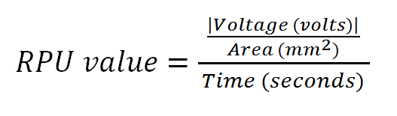
Solution: Intensity of Rainfall Measured Through New Unit
New unit to describe the amount of precipitation energy (Rain Power Unit)
Measures the impact force on a given area over a certain duration.
Solution takes into account impact velocity, precipitation element size and duration of weather event.

Slide 6
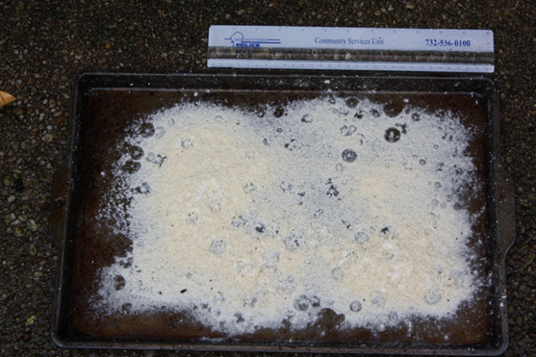
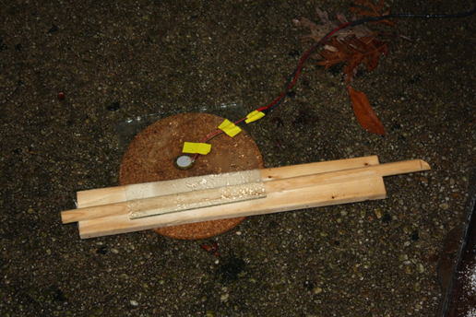
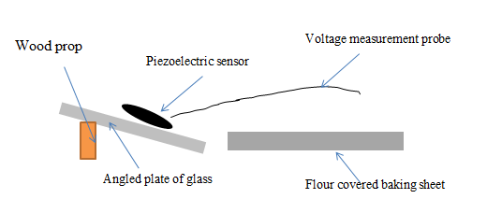
Methodology
Impact force measured with a piezoelectric sensor (voltage produced with deformation)
Precipitation element size @ moment of impact was measured with a flour covered baking sheet
Recorded Area at Moment of Impact
Voltage Measurement Setup

Slide 7
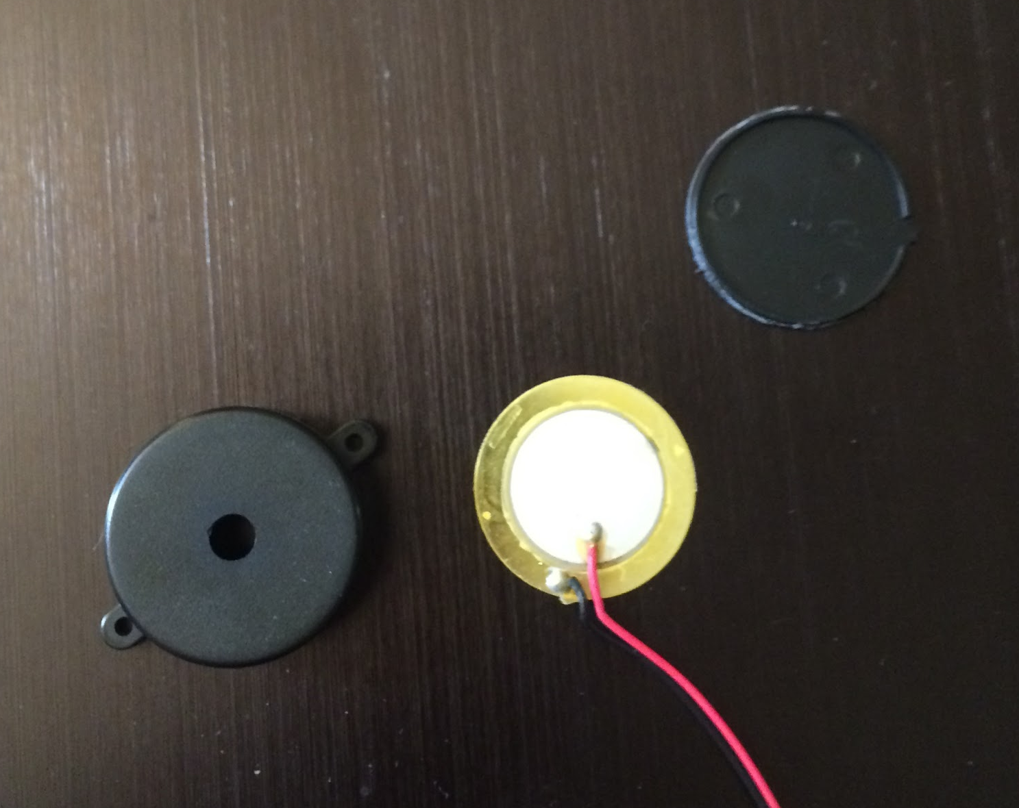
Reasoning
Piezoelectric component- produces voltage upon deformation (impact)
~$3 compared to $200+ force plate
Readily available
Flour- records size of precipitation element at moment of impact
Very inexpensive
Readily available
Most expensive component would be voltage sensor ($11)
Flour impact capture
Piezoelectric component

Slide 8
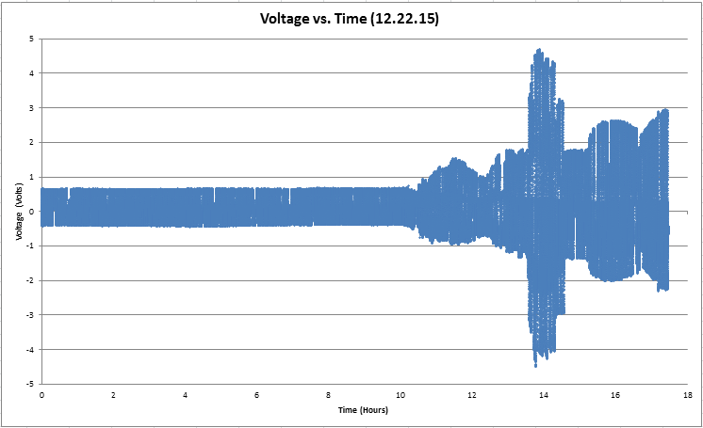
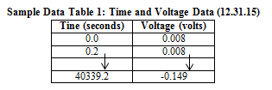
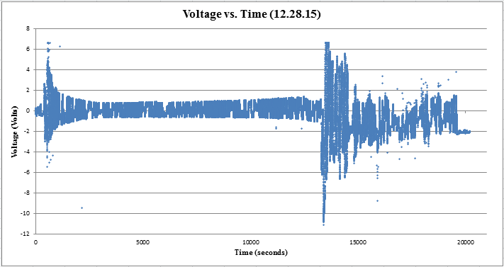
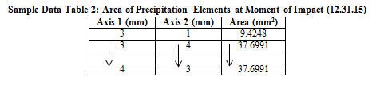
Raw Data
5 data points per second (18000/hr)
Voltage probe recorded time (s) and voltage (volts)
Axes of the precipitation element was measured in mm, then the area was calculated

Slide 9
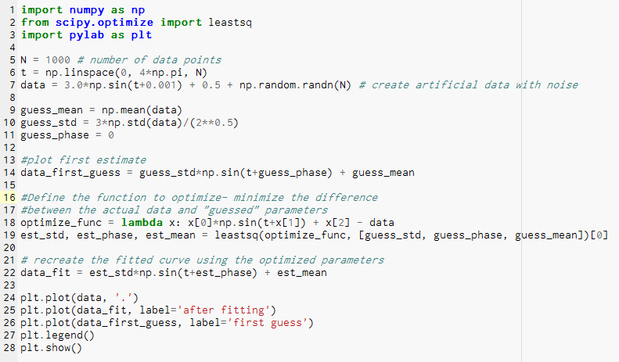
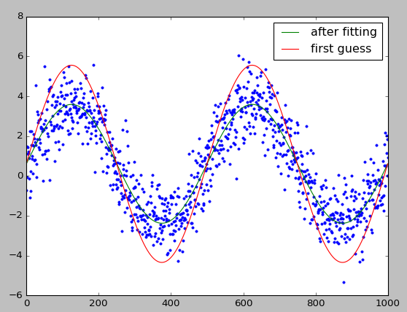
Data Analysis
Piezoelectric component has background noise.
Developed a Python program which was applied to the background noise to produce a sinusoidal regression
Regression was applied to main data in order to remove background noise
Offline post-hoc analysis due to the large volume of data (~400 000 per data set)

Slide 10
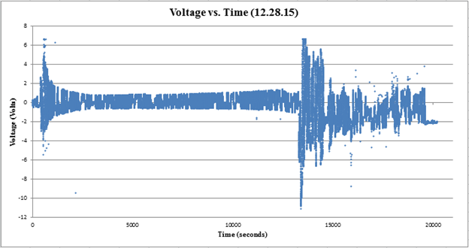
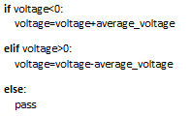
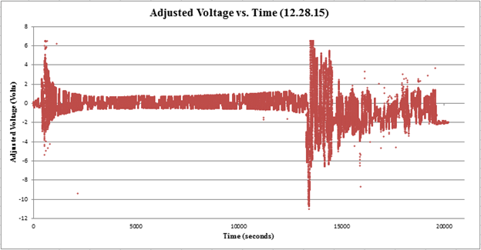
Data Analysis
Due to large volume of data (~400 000 points per data set), an Excel logic function was used.
Using the average voltage from the background noise, the actual data could be smoothed.
Sub-optimal since it places it closer to the average instead of removing the noise.

Slide 11
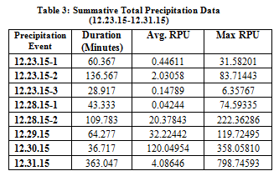
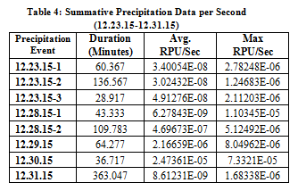
Typical Results After Data Analysis
Data shows that overall RPU values are not directly tied to duration of the precipitation event, as intended by the RPU formula.
12.31.15 event; long event can have a low average RPU value, but a high max RPU value (signifying a heavy rain at some point within the event).
12.30.15 event; shows that a short and intense event produces very high RPU values.
RPU values per second, essentially the combined RPU value of five data points.
12.30.15 event; high RPU per second, signifying a large quantity of precipitation elements in one second.
Within that event, there was a high max RPU per second, meaning that the elements had a high impact force per unit area.

Slide 12
Results and Conclusions
The improved protocol for precipitation measurement exceeded the original objective.
The RPU formula allows for more aspects of the precipitation event to be recorded and it also accounts for the interaction between them. Consequently, this protocol for measurement is far superior to the current size and accumulation methods.
The ideal approach would be to employ all three methods (size, accumulation, RPU) which produces the most descriptive analyses.
The new RPU precipitation protocol is superior to current precipitation methods, but does not supplant them.

Slide 13
RPU Applications
Engineering- A RPU value is essentially a measure of the energy of the precipitation element/event, so engineers can adjust their projects according to the required RPU strain. Currently, projects are often based on accumulation values, which are not a reliable measure of stress. With the implementation of this protocol, engineering safety practices could change drastically.
Weather Analysis- Having a better method of precipitation measurement will allow climate scientists to better categorize and analyze weather events. Ergo, the scientists will have a more complete model/record of any events they wish to study.
Weather Prediction- If meteorologists can provide an RPU estimate for the weather event, people can prepare accordingly since RPU provides information about the weather event’s duration, intensity, and precipitation elements, all in all leading to more descriptive predictions.

Slide 14
Citations
Ailsa Allaby and Michael Allaby. "raindrop." A Dictionary of Earth Sciences. 1999. Retrieved March 16, 2016 from Encyclopedia.com: http://www.encyclopedia.com/doc/1O13-raindrop.html Simple definition of a raindrop
Austin, P. M. (1947, August). Measurement of Approximate Raindrop Size by Microwave Attenuation [Scientific Paper].
In AMETSOC Journals. Retrieved January 2, 2016, from http://journals.ametsoc.org/doi/pdf/10.1175/1520-0469(1947)004%3C0121%3AMOARSB%3E2.0.CO%3B2 Details a method of measuring raindrop size using microwaves
CoCoRaHS - Community Collaborative Rain, Hail & Snow Network. (1998). Retrieved January 2, 2016, from http://www.cocorahs.org/Content.aspx?page=measurerain How to read rain gauges
How to Measure Rain. (n.d.). Retrieved January 2, 2016, from http://www.wikihow.com/Measure-Rain Describes a common method of measuring rainfall
Imaoka, K. , Japan Aerospace Exploration Agency. (2014 Feb, 17). Global Precipitation Measurement (GPM): an international mission for measuring global precipitation. The 51st session of the Scientific and Technical Subcommittee of COPUOS [Presentation- Vienna, Austria ]. Retrieved January 2, 2016, from http://www.unoosa.org/pdf/pres/stsc2014/tech-41E.pdf Presentation detailing the relevance of the NASA GPM mission and its objectives.
Kubota, T., Yoshida, N., Urita, S., Iguchi, T., Seto, S., Meneghini, R., . . . Oki, R. (2014, September). Evaluation of Precipitation Estimates by at-Launch Codes of GPM/DPR Algorithms Using Synthetic Data from TRMM/PR Observations (Scientific Paper, Earth Obs. Res. Center, Japan Aerosp. Exploration Agency, 2011). IEEE Journal of Selected Topics in Applied Earth Observations and Remote Sensing, 7(9), 3931-3943. First given at the International Geoscience and Remote Sensing Symposium (IGARSS), 2011 IEEE International

Slide 15
Citations
Lemone, P., Dr. (2013). Measuring rainfall – it’s easy and difficult at the same time [Web log post]. Retrieved January 2, 2016, from http://scied.ucar.edu/blog/measuring-rainfall-–-it’s-easy-and-difficult-same-time-0 UCAR Center for Science Education- details the difficulties of precipitation measurement
Marshall, J., PhD. (2016, February 12). How Is Rainfall Measured? [Web log post]. Retrieved February 18, 2016, from http://www.quickanddirtytips.com/education/math/how-is-rainfall-measured Details the various methods of rainfall measurement
McClymont, A. (2013). Raindrop 2013 [Art project that examined the properties (focus on shapes) of raindrops]. Retrieved January 2, 2016, from http://www.alistairmcclymont.com/artwork/raindrop Based on an experiment at the University of Manchester in the early 1970s performed by C. P. R Saunders and B. S. Wong.
Measuring the Rain. (2002). Retrieved January 2, 2016, from http://www.infoplease.com/cig/weather/measuring-rain.html Describes rainfall/snowfall conversions
NASA’s Real World: Measuring Raindrops. (n.d.). Retrieved January 2, 2016, from https://www.nasa.gov/pdf/462953main_RW6-MeasuringRaindrops_508.pdf NASA guide on how to measure raindrops with explanations
National Aeronautics and Space Administration, Global Precipitation Measurement Core Observatory. (n.d.). Dual-frequency Precipitation Radar [Press release]. Retrieved January 2, 2016, from http://pmm.nasa.gov/gpm/flight-project/dpr Overview of one of NASA's precipitation measurement devices on their GPM observatory

Slide 16
Citations
National Aeronautics and Space Administration, Sharing Earth Observation Resources eoPortal Directory. (n.d.). Https://directory.eoportal.org/web/eoportal/satellite-missions/g/gpm [Press release]. Retrieved January 2, 2016, from https://directory.eoportal.org/web/eoportal/satellite-missions/g/gpm Detailed report of NASA's GPM mission including diagrams, specifications and processes
NOAA Satellite Research to Operations Transition Survey for Global Precipitation Measurement (GPM) Mission. (n.d.). Retrieved January 2, 2016, from http://www.nws.noaa.gov/mdl/RITT/lotm/docs/GPM_transition_survey_V1.0.pdf Detailed objectives and planned execution of the NASA GPM mission
Pearson, J. E., & Martin, G. E. (1957, November). An Evaluation of Raindrop Sizing and Counting Techniques (Rep.). Retrieved January 2, 2016, from Illinois State Water Survey and University of Illinois website: http://www.isws.illinois.edu/pubdoc/cr/iswscr-10.pdf Discusses various techniques of counting raindrops and their sizes
Rain Gauge. (2006, February 14). Retrieved January 2, 2016, from https://en.wikipedia.org/wiki/Rain_gauge Details what a rain gauge is and how it works
Stott, H. (May 2014). Colliding Raindrops: How Particles Increase Their Size (Project Thesis for degree of Masters of Engineering). University of Bristol. Retrieved January 2, 2016, from http://seis.bris.ac.uk/~hs0849/Raindrops_report.pdf Explanation for how raindrops increase in size, as well as their collisions
The Anatomy of a Raindrop. (n.d.). Retrieved January 2, 2016, from http://pmm.nasa.gov/education/videos/anatomy-raindrop Explanation of the parts of raindrops
Tomlinson, C. (2013). A low-cost experiment for determining raindrop size distribution. Retrieved January 2, 2016, from http://www.metlink.org/wp-content/uploads/2013/06/weather_raindropsize.pdf Provides a way to measure raindrop size at the moment of impact

